Slide 1
Strategy Deployment 2nd Level Workshop

Slide 2
Purpose & Learning Objectives
Purpose:
Familiarize members with the mechanics and architecture of the 2nd Level Strategy Deployment Workshop. This virtual training will assure members a more efficient and meaningful workshop experience as they create their respective 2nd Level Strategy Deployment Matrices.
Learning Objectives:
Participants will learn the various steps in creating their 2nd Level Strategy Deployment Matrices, including the following:
Annual Improvement Priorities
Strategy Deployment Targets
Strategy Deployment Teams

Slide 3

Strategy Deployment 2nd Level Workshops
We Will Develop:
2nd Level Annual Improvement Priorities (AIPs)
Strategy Deployment Targets
Cross-functional Teams
Action Plans

Slide 4

Strategy Deployment 2nd Level Workshop
Develop 2nd Level Annual Improvement Priorities (AIPs)

Slide 5

7 Phases of the Strategy Deployment Process
Based on the Deming Cycle - PDCA
Develop LRP
Plan
Develop Long-Term Stretch Objectives
Catchball
Do
Check
We are here!
Act
Develop AIPs, Targets Top Level
Develop AIPs, Targets, Resources - 2nd Level
Targeted
CI Efforts
8D
Counter-
measures
Implement AIPs
Monthly PDCA Review
Annual Review
QUESTION: Where could be the failure point in your organization?
Notes:
DO: BREIFLY walk the group through this chart noting that you will be taking them through each step in the process in great detail. Key points to stress:
Strategic Deployment is a PROCESS.
The SD process is mirrored after the PDCA cycle.
You must do ALL of the steps to be successful.
Most companies fail by not implementing steps 5 & 6.
Just because you “Planned” does not mean you did SD.
Note the considerable amount of steps in “Plan” vs. other steps. This is typically a Japanese philosophy where they will spend more time in Planning and a small amount of time in the execution (DO) stage. This is sometimes the opposite thinking of traditional Western management.
SAY: “This cycle is based on the Deming Cycle, or the Plan-Do-Check-Act cycle. When leading with Strategic Deployment your business and its processes will continuously be at different points of implementing this cycle. Notice that it is a cycle (and there are cycles within the cycle) because continuous improvement never ends.

Slide 6
Second Level Annual Improvement Priorities Defined
Definition
Characteristics
Pitfalls
Derived from a Top-Level Annual Improvement Priority (AIP)
Is a subset of higher-level tasks supporting a top level AIP
Should describe a process
Several Second level AIPs can exist for each top-level AIP
Each Second level AIP will be assigned to a cross-functional team
Each Second level AIP will have a corresponding action plan
Although termed “annual,” they could exist for less than one year, or last longer than one year, depending on the nature of the AIP
AIP Structure too detailed/low level, too vague, or too large of a task
Too many Second level AIPs for the assigned team/ resources
Second level AIPs to not achieve intended target of the corresponding Top-Level AIP
2nd Level AIPs Must Get to the Point of Impact
Notes:
Ask:

Slide 7
Second Level AIP Examples
Top Level AIP Corresponding Second Level AIPs
1
Implement new and/or
optimize existing
Talent Management
Processes
Implement new and/or improve Career Development Processes
Implement new and/or optimize existing Performance Management Processes
Implement new and/or optimize Compensation Processes
Implement a new Robust Recruiting Process
2
Implement new and/or
optimize existing
Product Development
Processes
Implement a new Voice of the Customer Process
Implement new and/or optimize existing Tollgate Management Processes
Implement new Design for Manufacturing and Assembly Processes (DFMA)
Implement Pro Engineering Software
3
Implement a new
and/or improve
Supplier Certification
Process
Implement new and/or optimize existing processes to identify and recruit new suppliers
Implement new and/or improve existing processes to test supplier’s capabilities to ensure they will consistently meet the standards set by the company

Slide 8

AIPs (Annual Improvement Priorities) - Checklist
Are AIPs (Annual Improvement Priorities)…
Tied to the established Long-Term Stretch Objectives?
Process-focused?
Customer-focused?
Measurable?
Supporting objectives identified in the LRP (Long-Range Plan)?
Enlisting cross-functional involvement?
Representing significant improvements?
Resulting in a new system or new way of doing business?
Not already learned? (Do we already know how to do it?)

Slide 9

Affinity Ground Rules for AIPs
Silent brainstorming…no discussion during Post-it writing exercise
At least 2 quality 2nd Level AIP Post-its per Top Level AIP
Everyone’s ideas are treated equally
One idea (AIP) per Post-it
Write name on the top of Post-it
Be clear; state the AIP in the form of a process:
  Wrong: Improve Material Costs
  Right: Implement new and/or optimize existing Supplier Certification Processes
Focus on the critical few ideas based on the Top Level AIPs and Breakthrough Objectives

Slide 10
Affinity Process for Brainstorming Second Level AIPs
Step 1: Each participant silently brainstorms 2 Second Level AIPs for each Top Level AIP
Write each Second Level AIP on a Post-it note
Step 2: Each participant individually shares Post-it notes aloud and then posts on board/flipchart
No judgments are cast yet about what is posted
Step 3: AIP Owner facilitates the grouping of like ideas
Each grouping must be given a title or category name
Notes:
DO: Review the process for how to facilitate this portion of the session.

Slide 11

Affinity Process for Brainstorming Second Level AIPs
Step 4: Using the AIP Analysis Tool, AIP Owner facilitates the “down-selection” process from 8+ ideas to the top Second Level AIPs
Step 5: Transfer Second Level AIPs to the Second Level Matrix
Notes:
Continued

Slide 12
AIP Priority Filter
High
“Just Do It”
“Strategy Deployment”
Impact/Value
“Daily Management”
“Backburner”
Low
Low
Complexity
High

Slide 13

Strategy Deployment 2nd Level Workshop
Develop 2nd Level Strategy Deployment Targets

Slide 14
Second Level Strategy Deployment Targets - Defined
Definition
Characteristics
Pitfalls
Derived from a Top-Level Annual Improvement Priority (AIP)
Is a subset of higher-level tasks supporting a top level AIP
Should describe a process
Several Second level AIPs can exist for each top-level AIP
Each Second level AIP will be assigned to a cross-functional team
Each Second level AIP will have a corresponding action plan
Although termed “annual,” they could exist for less than one year, or last longer than one year, depending on the nature of the AIP
AIP Structure too detailed/low level, too vague, or too large of a task
Too many Second level AIPs for the assigned team/ resources
Second level AIPs to not achieve intended target of the corresponding Top-Level AIP
2nd Level AIPs Must Get to the Point of Impact
Notes:
Ask:

Slide 15
Anatomy of Targets with Examples
VERB | NOUN | FROM X to Y | BY | DATE
Increase | Order Win Rate | From 25% to 40% | BY | 12/31/2024
Reduce | New Product Development Cycle | From 360 Days to 90 Days in Stage Gate 4 | BY | 12/31/2024
Reduce | Internal Quality PPMs | From 50,000 PPM to 5,000 PPM | BY | 12/31/2024
Improve | Employee Engagement Score | From 5.0 to 9.0 | BY | 06/30/2024
Notes:
DO: Give the class an example of a 2nd Level AIP and have them write 2 targets to improve on the lines provided:

Slide 16


Rate the Targets
Target Example | Good Example | Poor Example
Reduce lead time in NPD from 36 months to 12 months by 12/31/XX | l
Improve internal quality |  | l
Perform 20 Kaizens by 12/31/XX |  | l
Increase Organic Revenue from New Systems Sales from $30M to $45M by 10/31/XX | l
Implement Standard Work in Accounts Payable |  | l
Improve Productivity from $20,000/Day to $30,000/Day by 12/31/XX | l
Notes:
DO: Ask the class why these are good/bad examples of Targets.
ANSWERS:
Note that some of the “Bad” examples are in fact AIP’s (Implement Standard Work in Accounts Payable”.
Some are not aggressive enough: “Achieve 4% productivity improvement”
Note that there is a format that a target should follow:
WHAT TO IMPROVE FROM/TO BY WHEN: Example: Improve PPM Rejects from 50,000 to 5,000 by 12/31/XX.

Slide 17
Target Checklist
Measurable, at least monthly?
Quantifiable?
Time-bound?
Stretch for the organization?
Show a “from-to” range?
Support reaching the Long-Term Objectives?
Involved development data that is easily attained?
Have a true cause-and-effect relationship with the AIP?
Notes:
NOTE: You may not have a “yes” answer for each of these – but you should for most to qualify a target.

Slide 18

Strategy Deployment 2nd Level Workshop
Develop 2nd Level AIP Teams

Slide 19
Establishing Cross-functional Teams – Guidelines
As a rule, each AIP needs to have one team leader assigned as the AIP Owner.
Cross-functional team members need to be established for each AIP.
The following symbols are used to designate team resources:
  l Team Leader (AIP Owner)
  m Cross-functional Team Member
  u Ad-Hoc Team Member
The % of total available time needs to be established for each team member.
Total manpower load analysis needs to be completed to ensure that the resource load is manageable. (See next slide)
Notes:
SAY: “Note that just because someone gets assigned as a Secondary resource, this does not mean that they are any less responsible for implementing the AIP.”
SAY: “Note that most breakthrough AIP’s are multi-functional in nature and need to have a multi-functional team assigned.”

Slide 20
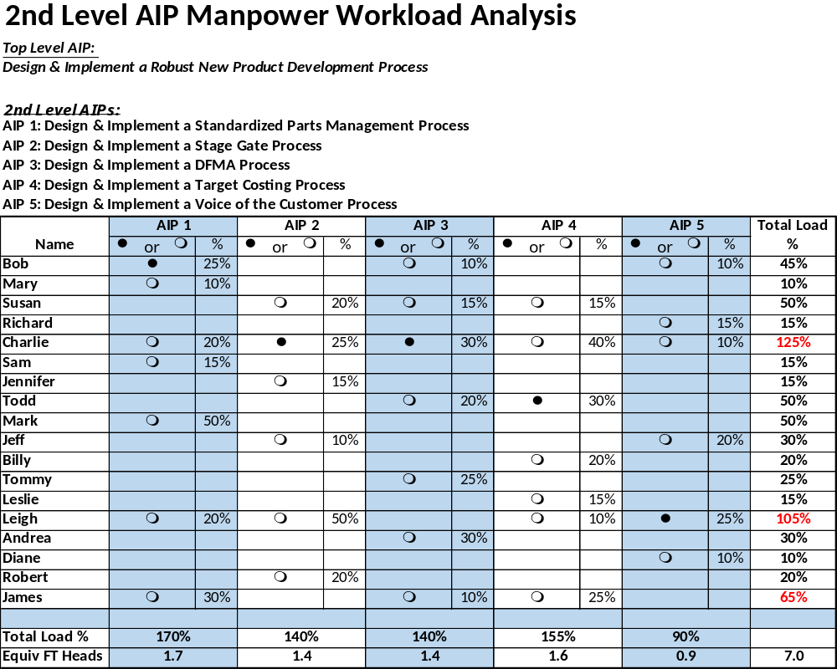
Potential Workload Capacity Conflicts
Notes:
SAY: “Note that just because someone gets assigned as a Secondary resource, this does not mean that they are any less responsible for implementing the AIP.”
SAY: “Note that most breakthrough AIP’s are multi-functional in nature and need to have a multi-functional team assigned.”

Slide 21

Role of 2nd Level AIP Teams
Responsible for the implementation of Second Level AIPs.
Responsible for achieving Second Level Targets.
Responsible for the completion of all Action Plan responsibilities.
Should meet frequently (at least once a week) to review progress.
Individuals assigned to the team will be given assignments by the AIP Owner where they may work independently or as a group on tasks delineated in the Action Plan.
Must meet monthly to review progress with the Target Sheet metrics and Countermeasure tools.
Notes:
SAY: “Note that just because someone gets assigned as a Secondary resource, this does not mean that they are any less responsible for implementing the AIP.”
SAY: “Note that most breakthrough AIP’s are multi-functional in nature and need to have a multi-functional team assigned.”

Slide 22

Strategy Deployment 2nd Level Workshop
Develop Action Plans

Slide 23
Action Plans
Definition
Characteristics
Pitfalls
Action Plans are the “recipe” to create a sustainable business process
Includes the necessary steps to create the 2nd Level AIP
The process is the end result of a completed action plan
Created at the “Point of Impact” (2nd Level AIP)
It is a dynamic document that is reviewed and updated on a weekly basis
Contains:
  Description of the Task
  Responsibilities
  Due Date
  Completion Date
  Status
Action Plan not focused on the true implementation of the AIP
Scope Creep - Adding “pet projects” to the Action Plan that has little to do with the creation of the AIP
Too many items resulting in the lack of prioritization of tasks
Too much load on any one team member
Action Plans Must Hit the “Point of Impact”

Slide 24

Hoshin Action Plan
2nd Level Matrix
Alternate
Owner:
Owner
AIP (Annual Improvement Priority):
Target Number One:
Target Number Two:
Target Number Three:
Target Number Four:
AIP Owner:
Alternate AIP Owner:
On Plan
Team Members:Enter Name followed by (Initials) Use Initials in Owner Cell
Off Plan, but almost done
Off Plan
Timeline
Complete
Action Steps / Kaizen Events
Owner /
Inter-Relationship / Notes
Members
Planned Start
Planned
Actual
Jan
Feb
Mar
Apr
May
June
July
Aug
Sept
Oct
Nov
Dec
Initials
Date
Completion Date
Completion Date

Slide 25

Strategy Deployment Architecture
Populate Your Team’s 2nd Level Matrix

Slide 26
Top Level and 2nd Level Strategy Deployments
- Illustrative Example
A company consists of many, many processes.
Most need to be continually improved through the Kaizen process. This is known as Daily Management.
Few key processes are selected to be significantly improved which will strategically provide profitable, competitive advantage. These processes are the focus of Strategy Deployment.
We cannot work on all things, so prioritization is key.
Selected Strategy Deployment processes need to be further broken down into their respective elements in order to focus our improvement efforts. This happens at the 2nd Level of the Strategy Deployment process.
Top Level
Strategy Deployment AIP
Design & Implement a Robust New Product Development Process
Design & Implement a Standardized Parts Management Process
Design & Implement a Stage Gate Management Process
Design & Implement a DFMA Process
Design & Implement a Target Costing Process
Design & Implement a Voice of the Customer Process
2nd Level
Strategy Deployment AIPs
1
2
Targeted Strategy Deployment Processes
3
Daily Management Processes
4
5

Slide 27
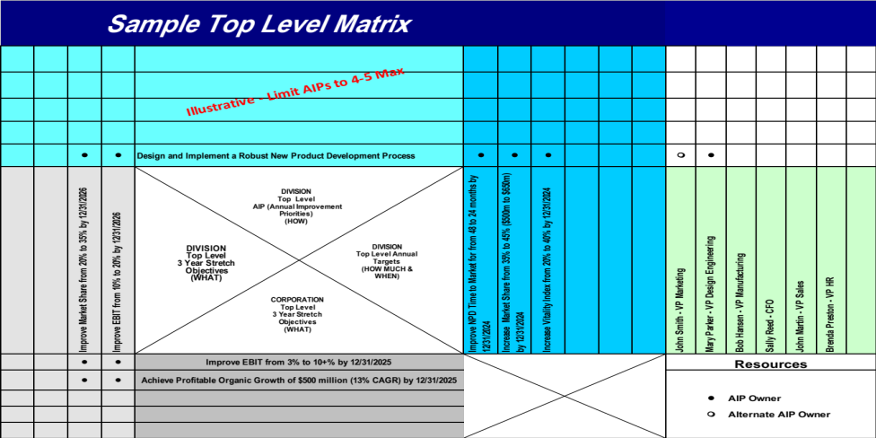
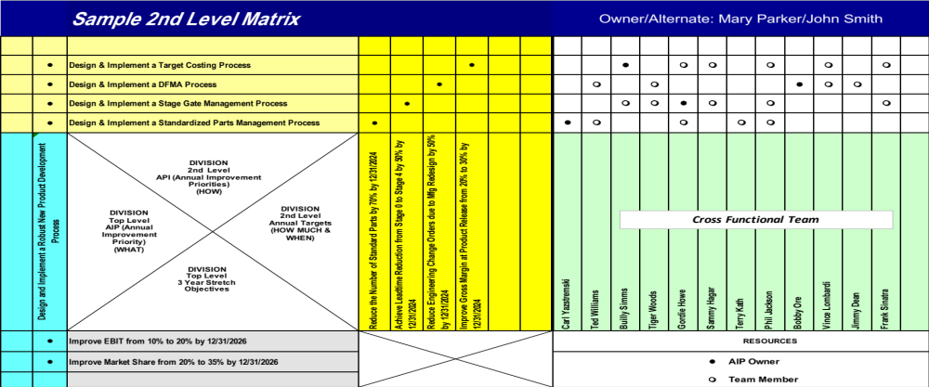
How do the Top Level and 2nd Level Strategy Deployment Matrices Connect?
Developed by 2nd Level Strategy Deployment Team

